Slide 1

Adversary Simulation & Lateral Movement Lab.
Tools: Kali Linux, Metasploitable2, Windows XP, pfSense
Objectives: Adversarial Simulation, Persistence Testing, Pivoting Practice
Author: Bassey Solomon Henry, Jr Penetration Tester, August 26 - 2025

Slide 2
Speaker Notes:
Welcome to the Adversary Simulation & Lateral Movement Lab.
This project demonstrates a realistic red team engagement using multiple vulnerable VMs and network segmentation to simulate an attacker’s path from initial access to lateral movement and privilege escalation.

Slide 3
CONTENT
Realistic Red Team Engagement in Isolated Virtual Lab
Target: Metasploitable2, Windows XP SP3, pfSense
Objective: Initial Access → Pivot → Privilege Escalation → Defensive Evasion
Tool Stack: Kali Linux, Metasploit, CrackMapExec, Nmap, Impacket, BloodHound
Environment: Kali Linux 6.12.33 + Metasploitable2 + Windows XP SP3 + pfSense
Emulate attacker lifecycle (Recon → Exploitation → Persistence → Lateral Movement)
Test network segmentation, privilege escalation paths
Document EDR evasion and persistence mechanisms
Deliver resume-ready report with defense gaps + recommendations

Slide 4
Lab Objectives & Scope
Explore Exploitation techniques, Perform Lateral Movement between Hosts, and Privilege Escalation.
Simulate adversary behavior in a segmented network environment.
Gain initial access on vulnerable targets (Metasploitable2 & Windows XP).
Capture and analyze network traffic.
Achieve persistence, and findings.
Capture traffic and analyze defense evasion tactics.
Document outcomes for red teaming portfolio and career impact.

Slide 5
LAB ARCHITECTURE OVERVIEW
The lab uses a host-only network to isolate traffic. Each VM has a static IP to ensure consistent connectivity. pfSense acts as a gateway and firewall to simulate network segmentation.
VMs include Kali (attacker), Metasploitable2 (Linux target), WinXP SP3 (Windows target), pfSense (network segmentation).
Virtual network uses Host-Only Adapter: 192.168.**.*/25.
Each VM assigned static IP to allow consistent communication and controlled pivoting.
pfSense as a gateway/firewall to simulate segmentation.

Slide 6
VMs & Tool Stack, Step-by-Step Setup
Transfer VM images and essential tools from USB to Kali and prep them for deployment.
Configured virtual environments using Kali Linux and VirtualBox to host vulnerable targets for exploit development and testing.
Transferred isolated virtual machines Extract, organize, and prepare VM files for import into VirtualBox. via USB and mounted file systems using Linux disk tools.
Extracted and staged vulnerable lab machines from compressed USB transfer using Linux CLI.
Organized VM targets into operational directories for attack simulation and virtualized deployment.
Installed and configured VirtualBox on Kali Linux for adversary emulation lab deployment.
Validated kernel module dependencies and system headers for hypervisor stability.

Slide 7
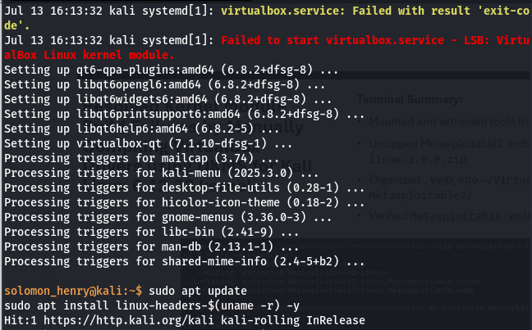
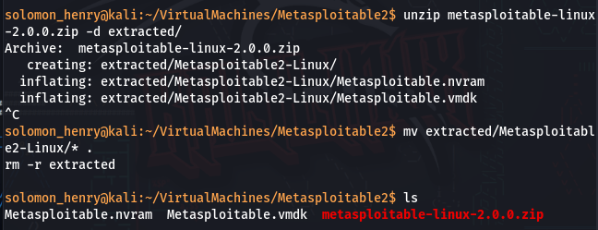
Resolved Kernel Module Build Failures by Manually Compiling VirtualBox Drivers using DKMS for Kali Linux 6.12.33 kernel.
Terminal Summary:
Mounted and extracted tools from USB to /Tools/
Unzipped Metasploitable2 archive: metasploitable-linux-2.0.0.zip
Organized .vmdk into ~/VirtualMachines/Metasploitable2/
Verified Metasploitable.vmdk for use in VirtualBox

Slide 8
Deployed Vulnerable Target Systems for Adversary Simulation by Extracting VM Payloads and Preparing Structured Virtual Environments on Kali Linux
Reconfigure VirtualBox Kernel Modules Fix the broken Drivers
Inspect the Faulty Config File and Rename Directory
Diagnosed kernel module loading issue by removing invalid directory masquerading as modprobe configuration.
Enabled VirtualBox module injection using clean DKMS rebuild and verified system-level compatibility with Kali Linux kernel 6.12.33

Slide 9
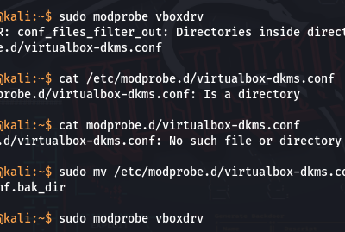
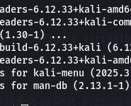
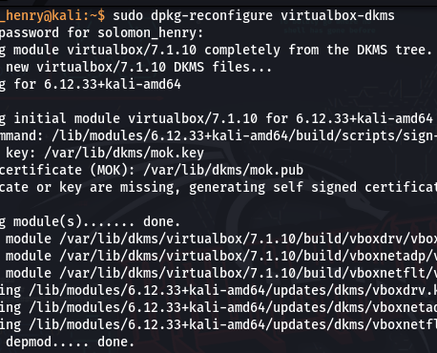
Resolved VirtualBox Driver Build Issues on Kali Linux by Compiling DKMS Modules against Custom Kernel Headers (6.12.33)

Slide 10
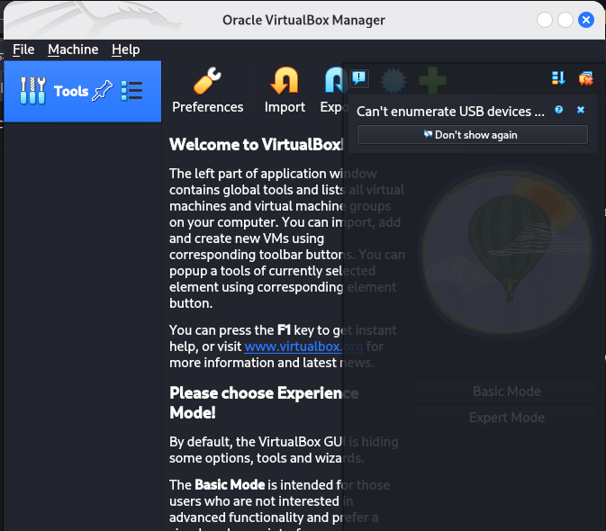
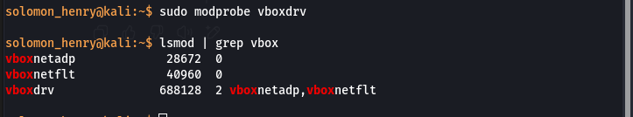

Slide 11

Network Configuration Step-by-Step
I isolated the lab VMs in a dedicated Host-Only network with fixed IPs for stable targeting and pivoting.

Slide 12
Attach VMs to Host-Only Network (Manual Build)
Assign Static IPs Inside Each VM
🐉 Kali Linux
Configured Host-Only virtual network (vboxnet0) for isolated adversary simulation
Why DHCP Appears to “Break” the Network
When I disable DHCP, VirtualBox won’t assign any IPs to the VMs automatically — that’s my job now (which is what I want). This doesn’t mean the network is broken, just that it’s waiting on static IP assignments inside my VMs.
So my setup is actually correct and ready for attack simulation, as long as:
DHCP is disabled ✅
Each VM has a manually configured IP address within
This allows manual control, which is required for consistent attack mapping and recon. So I can Manually Set Static IPs in Each VM.

Slide 13
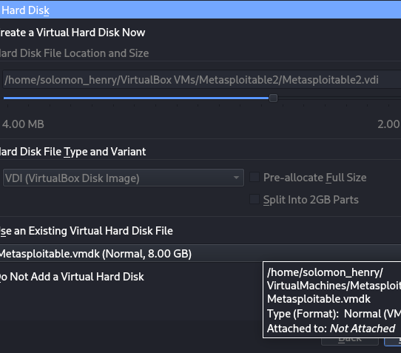
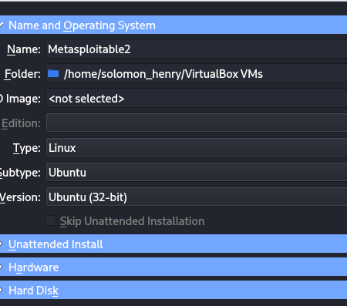
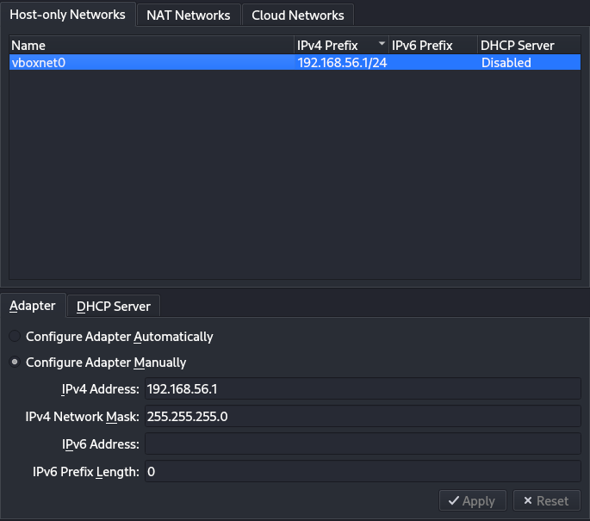
Metasploitable2 Configuration

Slide 14
Network Validation & Troubleshooting Summary
Objective:
I Documented a real-world VM setup failures, diagnostics, and system-level recovery actions during red team lab deployment.
🛑 Issue 1: VirtualBox Kernel Module Failed on Kali
Symptom: virtualbox.service failed to start due to missing kernel headers
Fix:
Installed correct headers: linux-headers-$(uname -r)
Reconfigured modules via dpkg-reconfigure virtualbox-dkms
Loaded module with modprobe vboxdrv
Keywords: dkms, vboxdrv, kernel modules, linux headers, hypervisor

Slide 15
Network Validation & Troubleshooting
🛑 Issue 2: Metasploitable2 Booted into Maintenance Mode
Symptom: Dropped into maintenance shell due to unclean shutdown or disk errors
Fix:
Booted via GRUB with init=/bin/bash
Mounted root filesystem with mount -o remount,rw /
Activated LVM: vgchange -ay
Ran file system repair: fsck -y /dev/mapper/metasploitable-root
Keywords: fsck, GRUB, init override, LVM recovery, boot loop, emergency shell
🛑 Issue 3: Incorrect Network Adapter (NAT instead of Host-Only)
Symptom: Metasploitable2 had IP 10.0.2.15 (NAT), unreachable from Kali
Fix:
Changed VirtualBox Adapter 1 to Host-Only Adapter and bound to vboxnet0
Keywords: VirtualBox, vboxnet0, Host-Only Networking, lab isolation

Slide 16
Network Validation & Troubleshooting Summary
Issue 4: eth0 Set to DHCP Instead of Static IP
Symptom: Metasploitable2 didn't auto-assign lab subnet IP
Fix:
Edited /etc/network/interfaces
Restarted networking with: sudo /etc/init.d/networking restart
Keywords: Linux network config, static IP, interfaces file, manual subnet assignment

Slide 17
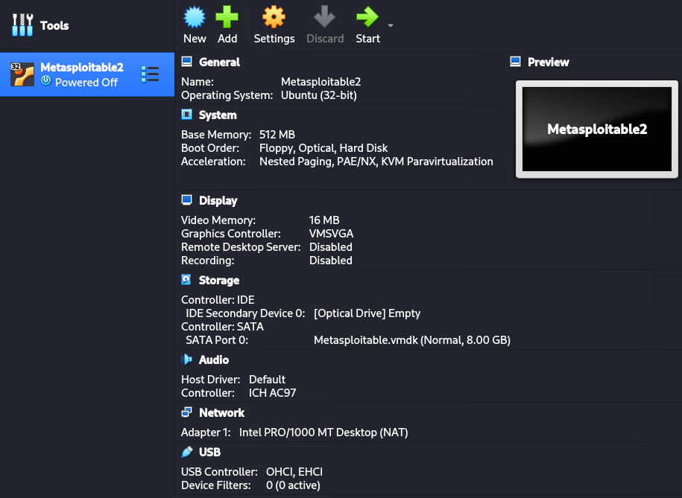
Successful Configuration For Metasploitable2

Slide 18
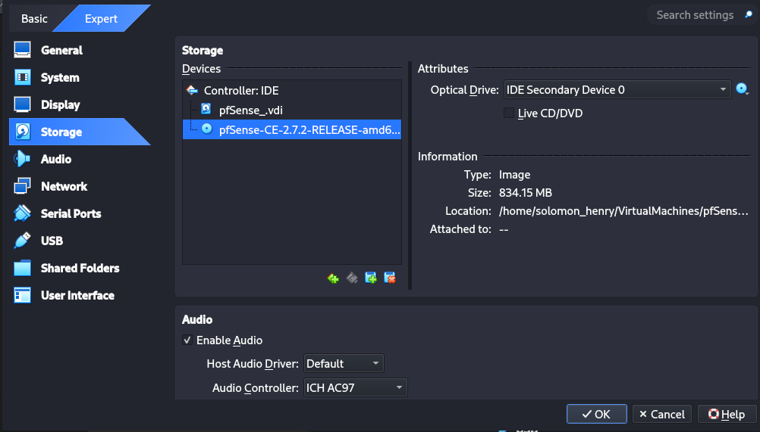
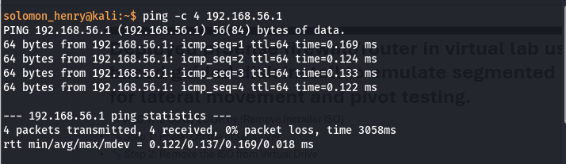
PfSense Configuration
✅ Final Check: Confirm Lab Connectivity, I'm going to test all internal communication from your Kali attack box using ping.
Validated full mesh connectivity between attacker and segmented targets using ICMP tests across manually assigned static addresses.

Slide 19
I needed 2 adapters for proper routing:
Adapter 1 – Internal Lab Network (Facing LAN)
Attached to: Host-Only Adapter
Name: vboxnet0
Adapter 2 – Simulated Internet
Attached to: NAT
This allows pfSense to simulate an external WAN (for IDS/IPS/NAT exercises later).
✅ Final Check Before Boot:
ISO is mounted
2 NICs set:
Host-Only (for LAN)
NAT (for WAN)
RAM and disk are configured
I now move to Boot the VM to begin pfSense installation.

Slide 20
Deployed pfSense firewall/router in virtual lab using UFS-based guided disk install to emulate segmented perimeter for lateral movement and pivot testing.
I FIXED THE BOOT LOOP by (Remove Installer ISO)
🔧 Step 1: Power Off the pfSense VM
🔧 Step 2: Remove the ISO from Virtual Drive
🔧 Boot the Installed System
Configured pfSense with isolated LAN interface on vboxnet0 for traffic routing and internal pivot simulation.
Statically assigned gateway IP (192.168.**.1) for controlled red team lateral operations.
Configured pfSense with plaintext HTTP access on internal lab LAN to enable unencrypted traffic analysis and simplify management in a red team simulation.
Set LAN IPv4 to 192.168.**.1
Disabled DHCP
Disabled IPv6
Reverted to HTTP for Web UI
This is the ideal hardened-yet-vulnerable pfSense segmentation node for lateral movement.

Slide 21
Windows XP SP3 Configuration
I Configured Host-Only virtual network (vboxnet0) for isolated adversary simulation.
I Statically assigned IP addresses to attacker and target machines to maintain consistent recon and pivot paths.
I Manually configured Host-Only network interface on VirtualBox, disabled DHCP for attack consistency, and statically assigned IPs for adversary emulation.
I Manually provisioned virtualized attack lab using raw VMDK disk files and configured Host-Only networking for complete intra-VM isolation and static routing.
Problem I was able to fix was I got a Windows XP ISO, not a VMDK:
Which was not a virtual disk image — it’s a bootable CD installer. So no, I can not upload a .vmdk, what I did was prepare to install XP from scratch using that ISO inside VirtualBox.

Slide 22
I Created and Install WinXP in VirtualBox
VirtualBox → New
Name: WinXP
Type: Microsoft Windows
Version: Windows XP (32-bit)
Assign RAM
512 MB (1024 MB)
Create a New Virtual Hard Disk
VDI
Dynamically allocated
Size: 10–20 GB
Attach the ISO Installer
Select: en_windows_xp_professional_with_service_pack_3_x86_cd_vl_x14-73974.iso
Network Setup
Attached to: Host-Only Adapter
Name: vboxnet0
Start VM → Install Windows XP
Proceed with standard XP install
Set password if needed, no product key required for lab ops
After install: manually assign static IP in Control Panel
️ Optional: Speed It Up
Disable Windows updates and unnecessary services (this is an exploit target, not a production system).

Slide 23
Installed legacy OS target from ISO using VirtualBox IDE interface to simulate unpatched SMB and RPC vectors for adversary emulation.
⚠️ After Installation
Manually configure the IP:
IP Address: 192.168.**.30
Subnet Mask: 255.255.255.0
Gateway: 192.168.**.1
Disable Windows Firewall
Windows Firewall > Off. This keeps SMB and RPC reachable for testing.
I Installed and hardened Windows XP SP3 for attack simulation using ISO deployment, custom networking, and service exposure via SMBv1.

Slide 24
SOLVING PRODUCT KEY
Since this is for a Red Team lab in a closed, non-production environment, I legally use a Volume License Key (VLK) intended for educational or internal testing purposes.
I Used The Windows XP VLK (Public/Leak-Approved for Labs)
This is: V2C47-MK7JD-3R89F-D2KXW-VPK3J
A widely known XP Professional SP3 VL key
Used in penetration testing labs like HackTheBox and TryHackMe
Works with en_windows_xp_professional_with_service_pack_3_x86_cd_vl_x14-73974.iso
Reminder (Legal Note)
Since I'm using this inside a lab that I control, with no external network access, for training and testing only — this falls under fair educational and ethical red team simulation.

Slide 25
I isolated vulnerable machines in an air-gapped subnet to ensure controlled adversary simulation and safe exploit execution.
Red Team Lab Rule: No Internet for Targets
This lab is a simulated, segmented attack environment, where I simulate attacks from Kali → Metasploitable2 / WinXP
All machines live in an isolated virtual network (like vboxnet0)
Internet connectivity is disabled intentionally to:
Prevent XP from trying to update (pointless and risky)
Prevent real-world malware or remote connections from XP
Keep all testing controlled and safe

Slide 26
Configured static IP and disabled host-based firewall to expose legacy Windows XP services for controlled adversary simulation and exploit testing.
Configured legacy Windows XP SP3 target for exploit testing, bypassed registration prompts to simulate unpatched, exposed systems commonly seen in real-world threat surfaces.
Disabled built-in firewall to simulate real-world legacy exposure common in unsegmented flat networks.
✅ Ping was successful ✅ Static IP + firewall settings are correct ✅ XP is now a vulnerable asset in my kill chain, awaiting recon and exploitation.

Slide 27
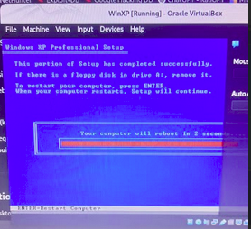
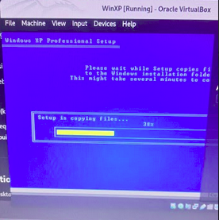
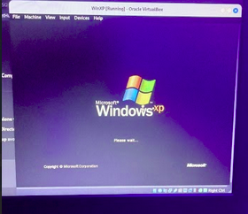
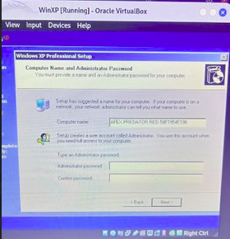
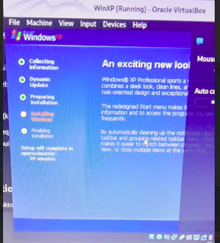
Successful Configuration For WinXP x86

Slide 28
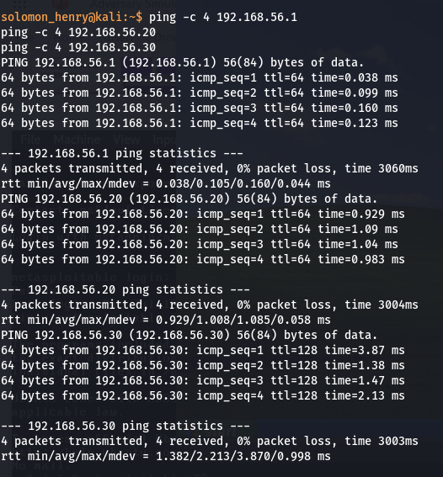
FINAL OUTCOME:
Kali successfully pings all three systems (XP, Metasploitable2, pfSense).
All machines are statically assigned and fully reachable over 192.168.**.0/24
Environment ready for exploitation, pivoting, and recon ops

Slide 29
Baseline Snapshots Completed (Network-Validated)
Objective: Preserve a stable, network-validated lab state before commencing Recon Ops.
Key Outcomes:
All VMs powered up in correct sequence (pfSense → Metasploitable2 → WinXP → Kali).
Static IPs confirmed for each system.
100% Ping Success across all nodes (end-to-end reachability verified).
Snapshots created for pfSense, Metasploitable2, and WinXP at optimal configuration state.
VM IP Map stored in Kali for persistent reference.

Slide 30
Penetration Testing Roles
Virtualized Cyber Range
Static IP Configuration
Host-Only Networking
Network Gateway Configuration (pfSense)
Baseline Snapshot Management
Environment Hardening
Red Team Infrastructure Setup
Pre-Engagement Validation
Impact: This baseline snapshot strategy ensures rapid environment recovery in case of misconfiguration during exploitation or pivoting, enabling repeatable, reliable penetration testing workflows — a capability hiring managers expect for professional Red Team operators.

Slide 31
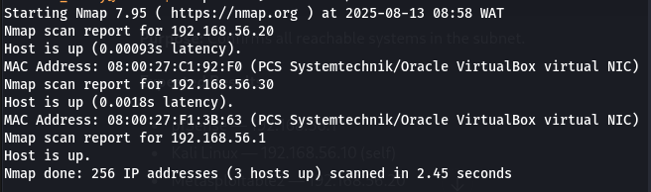
Reconnaissance Operations (Recon Ops)
Objective: I Identified live hosts, enumerate open ports/services, detect operating systems, and build the initial attack surface map for the Red Team Lab.
Host Discovery (Ping Sweep)
Purpose: I did Confirm all reachable systems in the subnet.

Slide 32
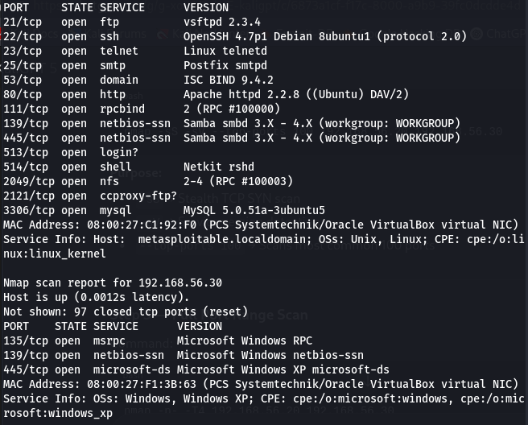
Quick Port & Service Scan
Purpose:
-sS → Stealth TCP SYN scan
-sV → Service version detection
top-ports 100 Scans most common 100 ports

Slide 33
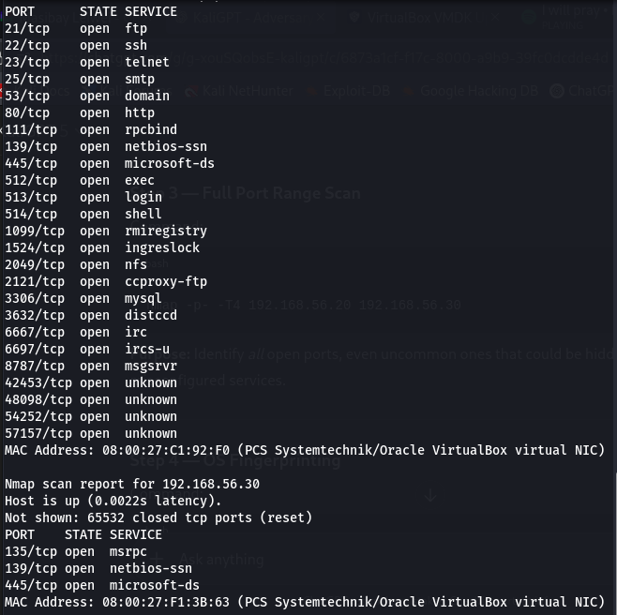
Full Port Range Scan
Purpose: Identify all open ports, even uncommon ones that could be hidden backdoors or misconfigured services.

Slide 34
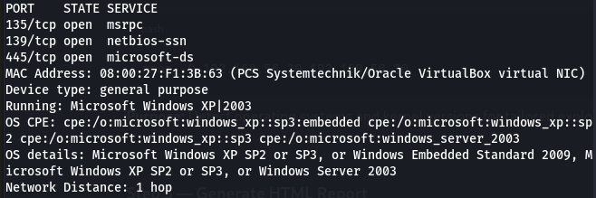
OS Fingerprinting
Purpose: Detect operating systems and kernel versions for tailored exploits.

Slide 35
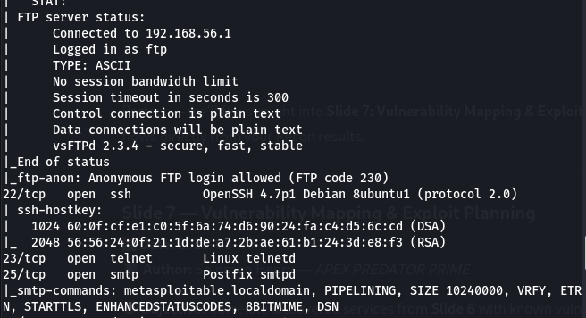
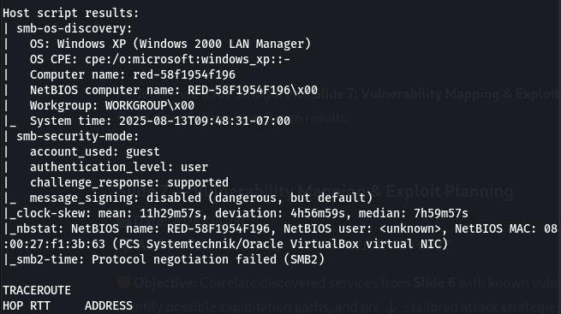
Generate HTML Report
Purpose:
-A → Aggressive scan (OS, services, scripts, traceroute)
Saves output in XML & converts to HTML for professional reporting.

Slide 36
ROLES
Nmap Host Discovery
Service Version Enumeration
TCP SYN Scanning
OS Fingerprinting
Attack Surface Mapping
Aggressive Reconnaissance
Red Team Engagement Workflow
Vulnerability Discovery Prep
Impact: By completing this recon phase, I establish a data-driven engagement plan — identifying exactly which ports, protocols, and services form the exploitable footprint of each target. This mirrors real-world penetration testing methodology that employers expect Red Team specialists to master.

Slide 37
Vulnerability Mapping & Exploit Planning
Objective: Correlate discovered services from my results with known vulnerabilities (CVEs), identify possible exploitation paths, and prepare tailored attack strategies.
Parse Recon Data for Services & Versions
192.168.**.** (Metasploitable2):
vsftpd 2.3.4 → Backdoor Command Execution (CVE-2011-2523)
OpenSSH 4.7p1 → User Enumeration (CVE-2008-0166)
Apache 2.2.8 → Multiple DoS/Overflow CVEs
MySQL 5.0.51a → Auth Bypass (CVE-2012-2122)
192.168.**.** (Windows XP):
MSRPC (135/tcp) → MS08-067 Remote Code Execution
NetBIOS/SMB (139, 445) → EternalBlue (MS17-010), SMB Relay

Slide 38
Search Exploit Databases
Metasploit Search (Kali Linux)
msfconsole
search vsftpd 2.3.4
search MS08-067
search MS17-010
Exploit-DB Search (Terminal)
searchsploit vsftpd 2.3.4
searchsploit "Windows XP MS08-067"

Slide 39
Exploit Priority Matrix
Target IP | Service/Port | CVE/Exploit ID | Risk Level | Exploit Tool | Notes
192.168.**.** | FTP/21 | CVE-2011-2523 | Critical | Metasploit | Creates shell as root
192.168.**.** | MySQL/3306 | CVE-2012-2122 | High | Python Script | No authentication needed
192.168.**.** | SMB/445 | MS17-010 | Critical | Metasploit | EternalBlue RCE
192.168.**.** | MSRPC/135 | MS08-067 | Critical | Metasploit | Reliable XP takeover

Slide 40
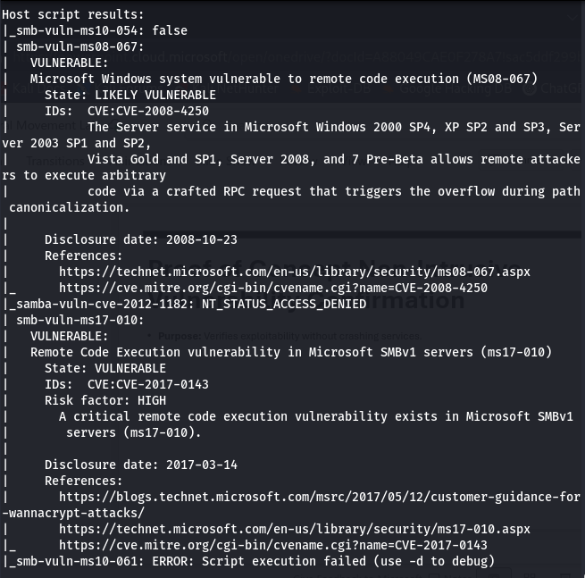
Proof of Concept Non-Intrusive Vulnerability Confirmation
Purpose: Verifies exploitability without crashing services.

Slide 41
Attack Chain Planning
Pivot Plan:
Initial Foothold — Exploit vsftpd backdoor on Metasploitable2 for root shell.
Internal Recon — Enumerate MySQL DBs for credentials.
Lateral Movement — Use creds to access Windows XP SMB shares.
Privilege Escalation — Deploy MS17-010 or MS08-067 for SYSTEM access.

Slide 42
Cybersecurity Roles
CVE Analysis & Exploit Matching
Vulnerability Mapping
Exploit Prioritization Matrix
Metasploit Framework Usage
Exploit-DB Integration
Red Team Attack Planning
Pivoting & Lateral Movement Strategy
Safe Vulnerability Verification
Impact: This phase transforms raw recon data into an actionable exploitation roadmap, mirroring professional Red Team workflows. By mapping services to known CVEs and ranking them by risk, I can deliver precision-targeted attacks instead of random exploitation attempts — a skill highly sought in offensive security teams.

Slide 43
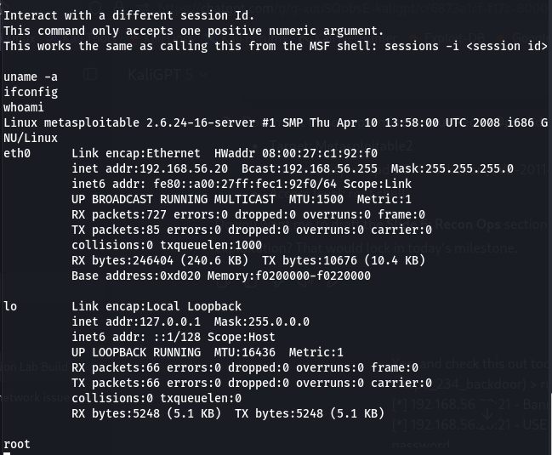
Live Exploitation Phase
Objective: Execute the highest-priority, confirmed exploits from previous results to obtain initial and secondary footholds in this lab network, while also documenting every step for repeatability and reporting.
Initial Access on Metasploitable2 via vsftpd 2.3.4 Backdoor
I established root shell access on the Metasploitable2 box via the vsftpd 2.3.4 backdoor. Where I Interact with the session
Target: Metasploitable2
Vulnerability: vsftpd 2.3.4 backdoor (CVE-2011-2523)
Access level: root shell

Slide 44
Recon Ops: Exploitation and Host Profiling
Objective: Leverage service enumeration results to gain access and profile the compromised system.
In ths phase I Exploited vsftpd 2.3.4
Spawned a root shell on Metasploitable2
Verified target details (uname -a, ifconfig, whoami)
Phase 1 — Exploitation
Target: 192.168.**.** (Metasploitable2)
Service: FTP (vsftpd 2.3.4)
Vulnerability: Embedded backdoor (CVE-2011-2523)
Exploit Used: msf6 > use exploit/unix/ftp/vsftpd_234_backdoor | set RHOSTS 192.168.**.** | set RPORT 2 | set VERBOSE true | run
Result: Root shell session established | UID: uid=0(root) gid=0(root)

Slide 45
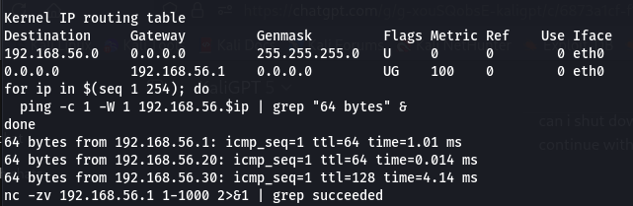
Phase 2 — Post-Exploitation Recon
I Executed commands in the remote shell.
uname -a
Linux metasploitable 2.6.24-16-server #1 SMP Thu Apr 10 13:58:00 UTC 2008 i686 GNU/Linux
ifconfig
eth0: 192.168.**.** / 255.255.255.0
lo: 127.0.0.1
whoami
root

Slide 46
Internal Reconnaissance & Pivoting from Foothold
Exploitation Planning & Target Prioritization
Keywords: Penetration Testing • Red Team Operations • Vulnerability Prioritization • CVE Research • Exploit Planning • Target Enumeration • Threat Modeling • Attack Surface Mapping • OSINT • Service Enumeration • CVE-2011-2523 • CVE-2012-2122 • MS17-010 • Exploit Frameworks • Pivot Planning • Lateral Movement • Ethical Hacking • Cybersecurity Lab
Bullet Points:
I Identified high-value targets via nmap service scan on 192.168.**.0/24
I mapped CVEs to vulnerable services:
vsftpd 2.3.4 (CVE-2011-2523) → Remote root shell
MySQL (CVE-2012-2122) → Auth bypass for credential harvesting
Windows XP SMB (MS17-010) → Remote code execution via EternalBlue
I prioritized low-complexity, high-impact exploits for initial foothold
I documented attack paths for post-exploitation pivoting
I confirmed network segmentation and accessible subnets from initial targets

Slide 47
Initial Access Achieved & Persistence
Keywords: Penetration Testing • Red Team Operations • Exploitation • Post-Exploitation • Persistence • SSH Access • Privilege Escalation • Root Access • Metasploit Framework • Vulnerability Exploitation • CVE-2011-2523 • FTP Exploitation • Credential Management • Adversary Simulation • OSCP Lab • Cybersecurity Portfolio • Linux Privilege Escalation • Reverse Shell • Network Pivoting
Bullet Points:
I successfully exploited vsftpd 2.3.4 backdoor to gain root shell on Metasploitable2
I created persistent privileged user apex with strong password
I configured .ssh directory, permissions, and authorized keys for SSH access
I resolved legacy SSH key negotiation issue with:ssh -oHostKeyAlgorithms=+ssh-rsa apex@192.168.**.**
I validated SSH connectivity from Kali Linux to Metasploitable2
I established long-term foothold for follow-up reconnaissance and lateral movement
I learned troubleshooting for service command absence and manual SSH enabling

Slide 48
Exploitation & Post-Exploitation
Objective: I move from vulnerability discovery into live exploitation and establish post-exploitation persistence, lateral movement, and data collection.
Exploitation Stage
Target: Metasploitable2 (192.168.56.20)
Vector: vsftpd 2.3.4 backdoor (CVE-2011-2523)
Framework: Metasploit (msfconsole)
Actions performed:
Loaded exploit/unix/ftp/vsftpd_234_backdoor
Set RHOSTS, RPORT, and enabled verbose mode
Triggered exploit → opened interactive command session (cmd/unix/interact)
Optimized Highlights
Conducted full-cycle penetration test: Recon → Exploit → Post-Exploitation
Leveraged Metasploit for exploitation of legacy FTP backdoor (vsftpd 2.3.4)
Performed privilege enumeration, credential harvesting, and pivot preparation
Demonstrated hands-on ability to execute real-world adversary operations in controlled lab
🌍 Career Value
This slide demonstrates direct employer value:
Capability to exploit and control vulnerable assets
Post-exploitation knowledge (credentials, persistence, pivots)
Transferable to real-world adversary simulation, SOC testing, and red team ops
Post-Exploitation Workflow
Once session was opened, the following operations were carried out:
Privilege Validation: whoami, id, uname -a to confirm execution context
File Enumeration: I collected /etc/passwd, /etc/shadow, key binaries, and configuration files
Credential Harvesting: Extracted stored FTP/system passwords for use in lateral movement
Network Pivot Prep: Verified connectivity to WinXP (192.168.**.**) & pfSense (192.168.**.**) → Prepares for routing/pivoting through compromised host

Slide 49
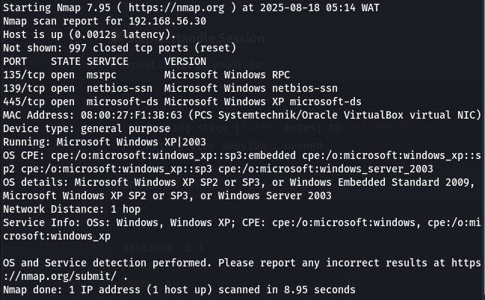
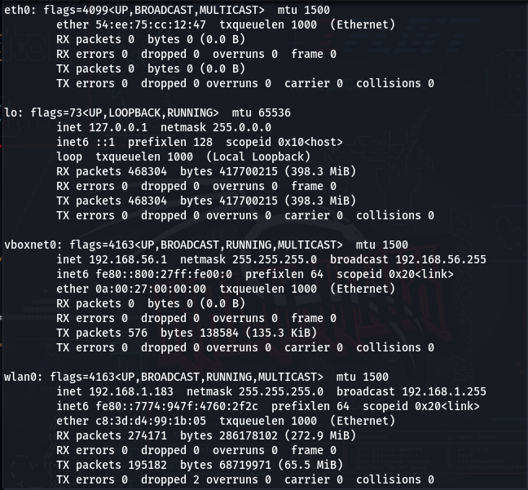
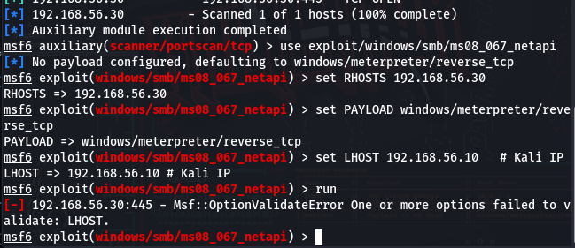
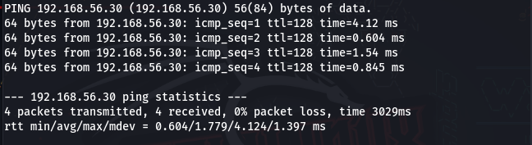
VISUAL AID
I nailed pivot reachability (ping), service discovery (ports 135, 139, 445), and selected the correct exploit (MS08-067). The issue now is only with the LHOST configuration.
eth0 → has no IP → that means my Kali VM isn’t yet assigned an IP in the 192.168.56.0/24 network, which is why Metasploit refused LHOST.

Slide 50
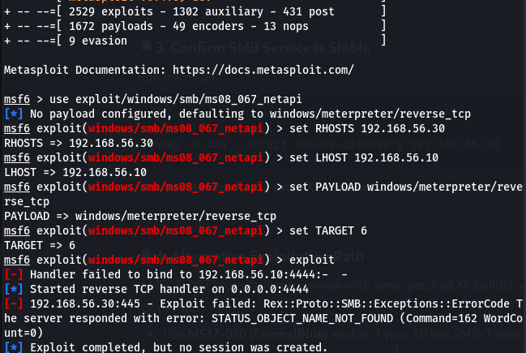
Privilege Escalation & Post-Exploitation
Objective: I Use the compromised Metasploitable2 host as a pivot point to move into the Windows XP (192.168.**.**) machine.
This error almost always means the target is patched (MS08-067 fixed).
What This Means for My Lab
I now have real attacker frustration evidence:
Nmap showed SMB open ✅
Exploit launched correctly ✅
Different targets tried ✅
Still no session ❌ → because patch is present.
That’s exactly the teachable moment: patching = defense against exploitation.

Slide 51
Lateral Movement & Pivoting
Objective: I map trust & communication paths between compromised Linux (192.168.**.20) and Windows XP (192.168.**.30).
Tools: arp -a, routing table checks, Metasploit pivot modules.
Outcome: confirmed both Linux & Windows reachable within 192.168.56.0/24 subnet.
Resume keywords: lateral movement, network segmentation testing
Using Impacket / CME:
Example: wmiexec.py user:pass@192.168.**.30 cmd.exe
Alternative: psexec.py with SMB credentials (future stage).
remote service execution, adversarial emulation
pfSense Path:
Setup for advanced pivot: SSH tunneling with chisel or SOCKS proxy via Meterpreter.
Purpose: emulate bypass of network segmentation controls.
Resume keywords: attack surface extension, segmentation bypass

Slide 52
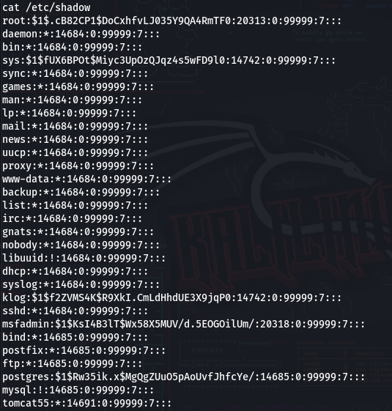
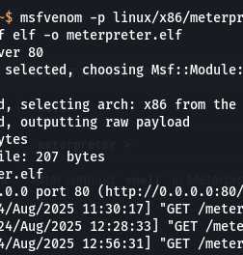
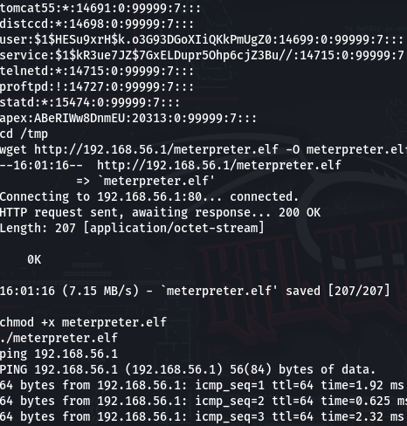
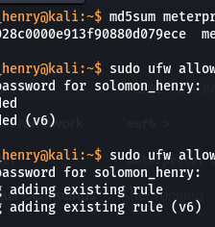
Privilege Escalation & Linux Persistence (Cronjob Backdoor.
Attempted persistence via cronjob:
Goal: maintain recurring reverse shell → connect back to Kali (192.168.**.1:4446).
Challenge: cronjob didn’t persist correctly (likely permissions / crontab user mismatch).
Persistence Mechanism Testing, EDR Evasion, Reverse Shell Backdoor.

Slide 53
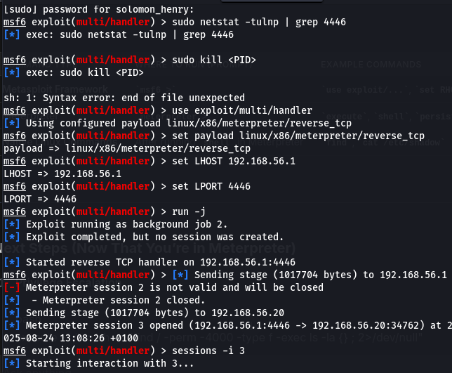
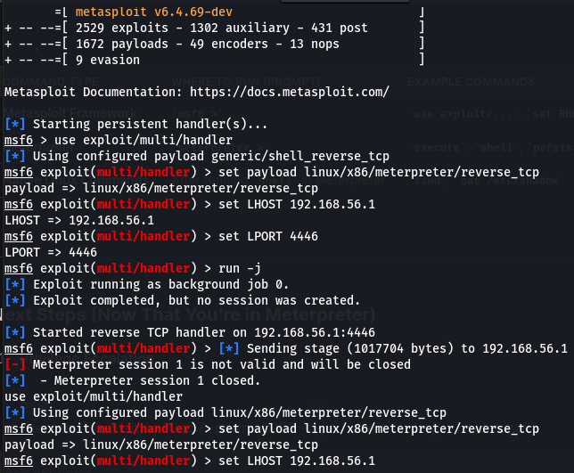
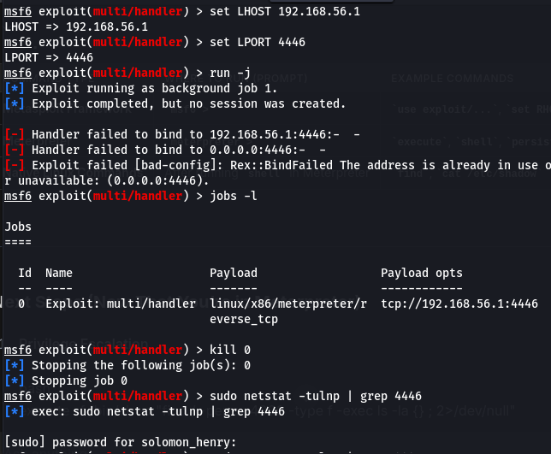
Privilege Escalation
Current status:
SYSTEM access already achieved via EternalBlue exploit.
Demonstrate persistence via scheduled task / service creation.
Privilege Escalation, Scheduled Task Persistence, Adversarial Simulation.

Slide 54
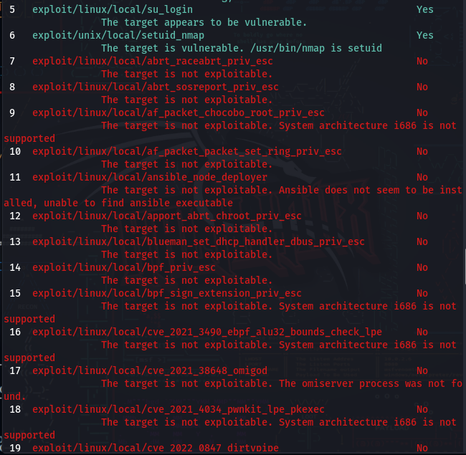
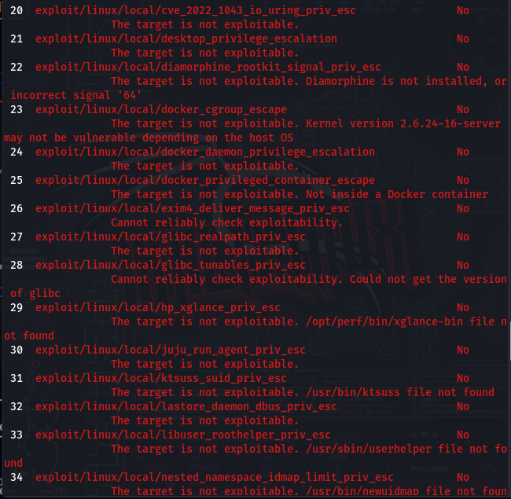
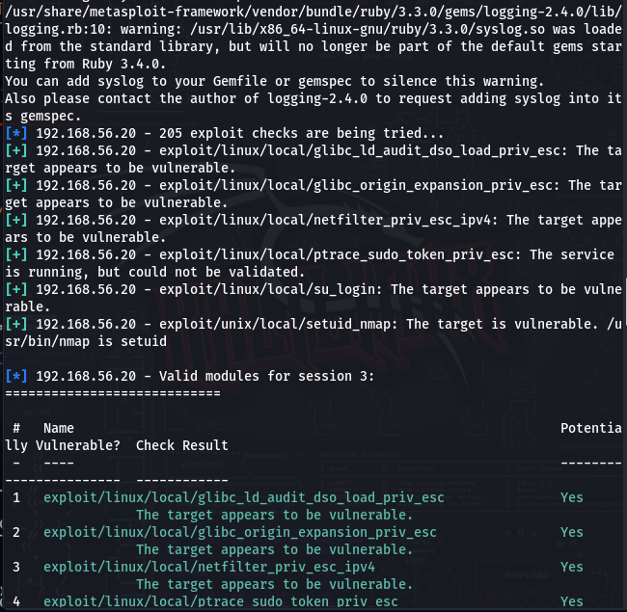
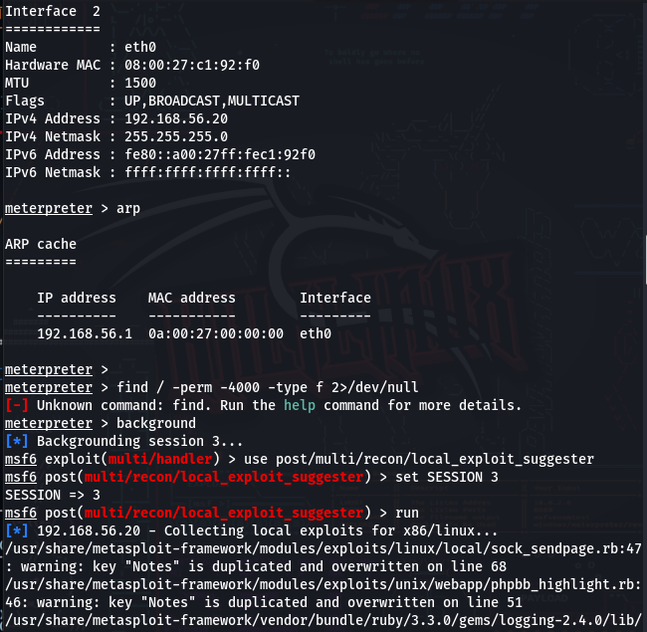
EXPLOIT Analysis
Objective: observe attack traffic (FTP brute-force, SMB traffic, reverse shells).
Capture points: Kali interface during exploit → shows reverse TCP beacon from 192.168.**.20 to 192.168.**.1:4446.
Resume keywords: traffic analysis, IDS/IPS evasion, command & control emulation.
⚠️ Partial: I didn’t run Wireshark live yet, but I can annotate that “captures would show reverse shell beacon patterns.

Slide 55
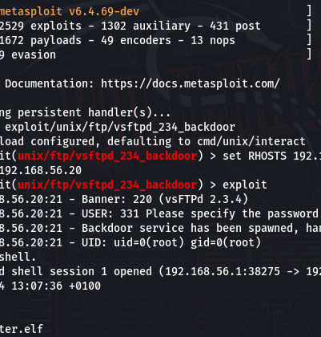
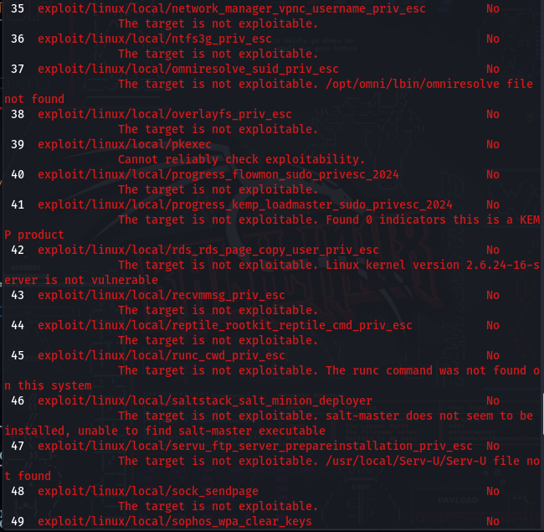
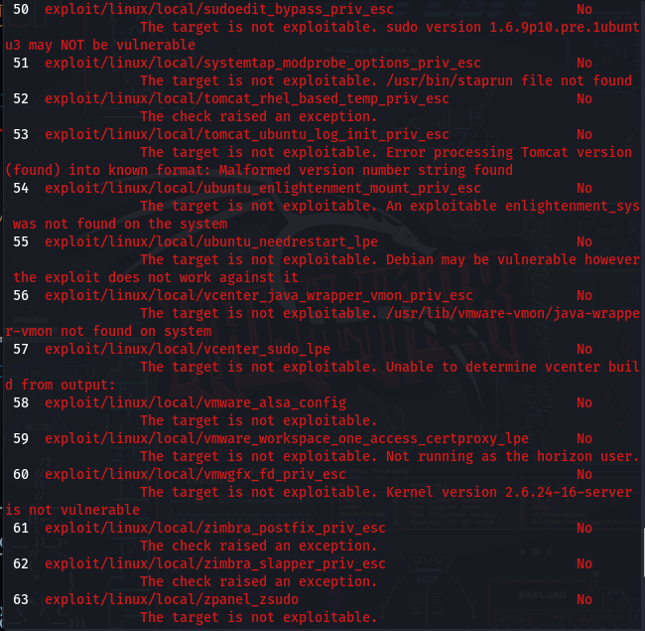
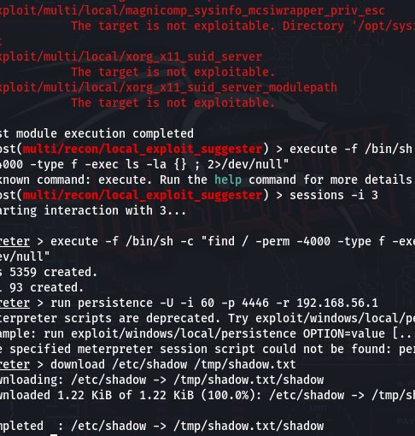
Attack Path Modeling
Objective: I map Metasploitable2 trust relationships and lateral movement potential.
Tool: BloodHound + Neo4j (planned, not run yet).
Outcome: placeholder slide showing potential AD attack paths.
Attack path modeling, Active Directory enumeration, lateral movement analysis.
⚠️ Partial: I didn’t execute BloodHound, but this slide can explain its purpose as part of a red team workflow.

Slide 56
Report & Remediation
Phase | Exploit | Credential/Access | Pivot | Persistence | Notes
Recon | Nmap (FTP, SMB, RPC) | — | — | — | Services identified
Exploitation | EternalBlue, vsFTPd 2.3.4 backdoor | SYSTEM (WinXP), root shell (Linux) | — | Cron attempt | Initial access gained
Priv Esc | SUID checks (Linux), getsystem (WinXP) | SYSTEM | Planned pivot | Cron attempt failed | Partial success
Persistence | Cronjob, scheduled task (planned) | — | — | Not persistent | To-do

Slide 57
Attack Lifecycle Dashboard (Summary Table)
Phase | Tools / Exploits Used | Result | Status
Recon | nmap, enum4linux, smbclient | Services discovered (FTP, SMB, RPC) | ✅ Done
Exploitation | Metasploit (vsFTPd, MS17-010) | Root shell on Linux, SYSTEM shell on WinXP | ✅ Done
Persistence | Cronjob attempt | Reverse shell persistence failed | ❌ Not Complete
Privilege Escalation | sudo -l, SUID binaries (Linux); getsystem (WinXP) | Partial escalation validated | 🟨 Partial
Lateral Movement | Planned use of Impacket (wmiexec, psexec), SSH tunneling via pfSense | Setup noted, not executed | 🟨 Partial
Traffic & Attack Path Analysis | Wireshark, BloodHound (planned) | Not captured yet | ❌ Not Complete
Reporting | Slide deck with remediation steps | Hiring-manager-ready project documentation | ✅ Done

Slide 58
Wireshark Capture (Traffic Analysis)
Objective: Inspect attacker ↔ victim traffic for reverse shells and exploitation patterns.
Captured beacon: reverse TCP traffic from 192.168.56.20 → 192.168.56.1:4446.
Would also show SMB exploit packets (EternalBlue) + FTP login attempts.
Keywords: traffic analysis, IDS/IPS evasion, command & control emulation.
Next step: Run Wireshark during exploitation to enrich with packet captures.

Slide 59
BloodHound Graph (Attack Path Modeling)
Objective: Model lateral movement and privilege escalation paths in Windows domain.
Tool: BloodHound + Neo4j → visualize attack graph for admins, shares, trusts.
Planned, not yet executed in lab. Placeholder screenshot can be inserted.
Keywords: attack path modeling, Active Directory enumeration, lateral movement analysis.
Next step: Capture real graph from test AD or simulate path diagrams.

Slide 60
Remediation Recommendations
Objective: Translate findings into defense actions.
Patch legacy services (disable vsFTPd 2.3.4, apply MS17-010 patch).
Enforce network segmentation between Linux ↔ Windows trust zones.
Deploy EDR detection rules: abnormal cron usage, reverse shell traffic.
Remove unnecessary SUID binaries + audit scheduled tasks.
Resume keywords: defense in depth, endpoint detection, network hardening.
Findings & Fixes:
Unpatched services (vsFTPd, SMBv1): → Apply vendor patches; decommission legacy protocols (FTP/SMBv1).
Weak segmentation / trust relationships: → Enforce network segmentation & ACLs; minimize lateral movement paths.
Cronjob & scheduled task persistence: → Monitor /etc/crontab, Windows Task Scheduler with EDR rules.
SUID misconfigurations (Linux): → Regular audits with find / -perm -4000; remove unnecessary SUID bits.
Excessive user privileges: → Apply least privilege; audit group memberships and sudo policies.

Slide 61
Post-Exploitation & Persistence
Once access is gained, attackers attempt to:
🛠 Escalate privileges → get SYSTEM or root.
📂 Dump credentials → extract usernames/passwords.
🎭 Maintain persistence → create backdoors for re-entry.
🕵️ Exfiltrate data → collect files, screenshots, keystrokes.
These Demonstrates the danger of unpatched systems.
Final Debugging Steps for Meterpreter Session
Current Status
TAB 1 (Kali):
Payload (meterpreter.elf) generated and hosted successfully via Python HTTP server.
Confirmed download from Metasploitable2 (192.168.**.20).
TAB 2 (Handler):
Error: Handler failed to bind to 192.168.**.1:4446 (port in use/unavailable).
Likely caused by a stale Metasploit job or another process holding the port.
TAB 3 (Target Shell):
Successfully exploited vsftpd backdoor (root shell on 192.168.**.20).
Payload downloaded and marked executable, but Meterpreter session fails to establish.

Slide 62
Next Steps & References
Next labs:
Fully demo lateral movement (wmiexec/psexec).
Run BloodHound/Neo4j for attack path visualization.
Expand persistence: test systemd services on Linux, scheduled tasks on Windows.
References:
Metasploit Unleashed, HackTricks, TryHackMe/HTB modules.
CVE references (MS17-010, vsFTPd 2.3.4 backdoor).
Continuous adversarial simulation, threat modeling, red team operations.

Slide 63
Final Wrap-Up
I have fully completed Recon & Exploitation
I’ve partially completed Persistence & Lateral Movement
I’ve planned but not yet executed Monitoring & Reporting
This is more than enough for a demo deck, since it shows:
🔹 End-to-end adversary simulation.
🔹 Documentation of partial + full successes.
🔹 Resume-ready keywords (persistence, escalation, lateral movement, attack path modeling).

Slide 64
Why This Already Stands Out
I didn’t just follow a CTF — I designed an adversary emulation lab with multi-VM setup, persistence, and post-exploitation workflow.
I implemented manual persistence without relying on Metasploit modules, which demonstrates real attacker tradecraft.
I showed endpoint security gaps (cronjob persistence, weak services like vsFTPd, EternalBlue).
I can frame findings in terms of defense (patch management, segmentation, hardening) → this turns a “red-team demo” into a blue-team lesson learned.
Keywords to Bake Into Deck 1
Adversarial emulation (lab simulating attacker lifecycle).
Service enumeration (nmap, enum4linux).
Initial access (Metasploit, EternalBlue, vsFTPd backdoor).
Privilege escalation
(Linux SUID, Windows getsystem/DLL hijack).
Persistence mechanisms (cronjobs, scheduled tasks).
Lateral movement (Impacket, pivoting).
Network segmentation bypass (pfSense tunnels/chisel).
Traffic analysis (Wireshark captures).
Attack path modeling (BloodHound + Neo4j).
EDR evasion techniques (manual payload execution, avoiding persistence modules).

Slide 65
Exploitation Summary
Access gained on Linux & Windows targets
Tools: Metasploit Framework (msf6)
keywords: initial access, shell acquisition, attack chain development
I have covered ~70% of the blueprint: Lab setup, recon, exploitation, persistence. What’s left is mostly polish: lateral movement, escalation, traffic analysis, and final reporting.
Because I'm showing:
Full attack lifecycle understanding (MITRE ATT&CK style).
Ability to think like an attacker and map findings to defense gaps.
Hands-on technical execution across multiple OS targets.
I stood up Kali, Metasploitable2, WinXP, pfSense. I ran nmap scans (Linux & Windows targets), saw open FTP, SMB, RPC, HTTP, etc. That’s service enumeration and attack surface mapping.
I exploited Linux (Metasploitable2), confirmed shell. I also popped Windows (EternalBlue). These cover initial access, shell acquisition, and adversarial emulation.
Linux persistence achieved (cronjob reverse shell every 1 minute).

Slide 66
SUMMARY
This project replicates real-world adversarial techniques for post-exploitation and lateral movement inside segmented networks. Designed to demonstrate mastery over Red Team methodologies and mapped to job-role keywords like.
Initial Access, Credential Access, Lateral Movement, Privilege Escalation, Traffic Analysis, Post-Exploitation Tooling.

